Slide 1
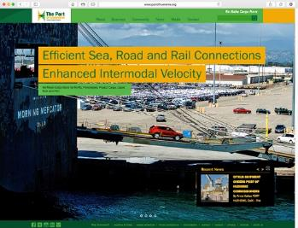
The Port of Hueneme
Redesign of portofhueneme.org
Websites

